Slide 1


Slide 2

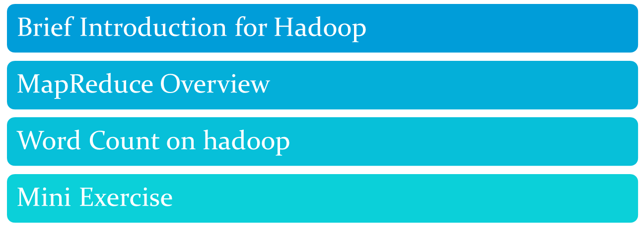

Slide 3
Hadoop
Formally speaking, Hadoop is an open source framework for writing and running distributed applications that process large amounts of data.

Slide 4
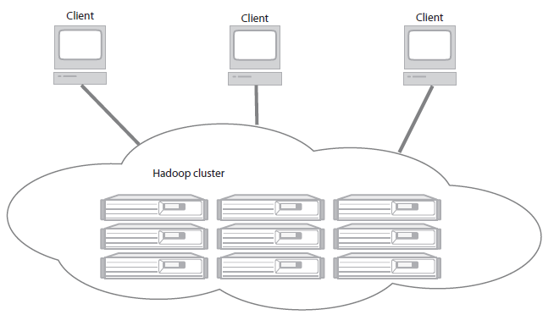
Hadoop
A Hadoop cluster has many parallel machines that store and process large data sets. Client computers send jobs into this computer cloud and obtain results.

Slide 5
Hadoop
Accessible—Hadoop runs on large clusters of commodity machines or on cloud computing services such as Amazon’s Elastic Compute Cloud (EC2 ).
Robust—Because it is intended to run on commodity hardware, Hadoop is architected with the assumption of frequent hardware malfunctions. It can gracefully handle most such failures.
Scalable—Hadoop scales linearly to handle larger data by adding more nodes to the cluster.
Simple—Hadoop allows users to quickly write efficient parallel code.

Slide 6

Motivation: Large Scale Data Processing
Want to process lots of data ( > 1 TB)
Want to parallelize across hundreds/thousands of CPUs
… Want to make this easy
"Google Earth uses 70.5 TB: 70 TB for the raw imagery and 500 GB for the index data."
From: http://googlesystem.blogspot.com/2006/09/how-much-data-does-google-store.html

Slide 7
MapReduce
Automatic parallelization & distribution
Fault-tolerant
Provides status and monitoring tools
Clean abstraction for programmers

Slide 8
Programming Model
Borrows from functional programming
Users implement interface of two functions:
  map (in_key, in_value) ->
  (out_key, intermediate_value) list
  reduce (out_key, intermediate_value list) ->
  out_value list

Slide 9
map
Records from the data source (lines out of files, rows of a database, etc) are fed into the map function as key*value pairs: e.g., (filename, line).
map() produces one or more intermediate values along with an output key from the input.

Slide 10
reduce
After the map phase is over, all the intermediate values for a given output key are combined together into a list
reduce() combines those intermediate values into one or more final values for that same output key
(in practice, usually only one final value per key)

Slide 11
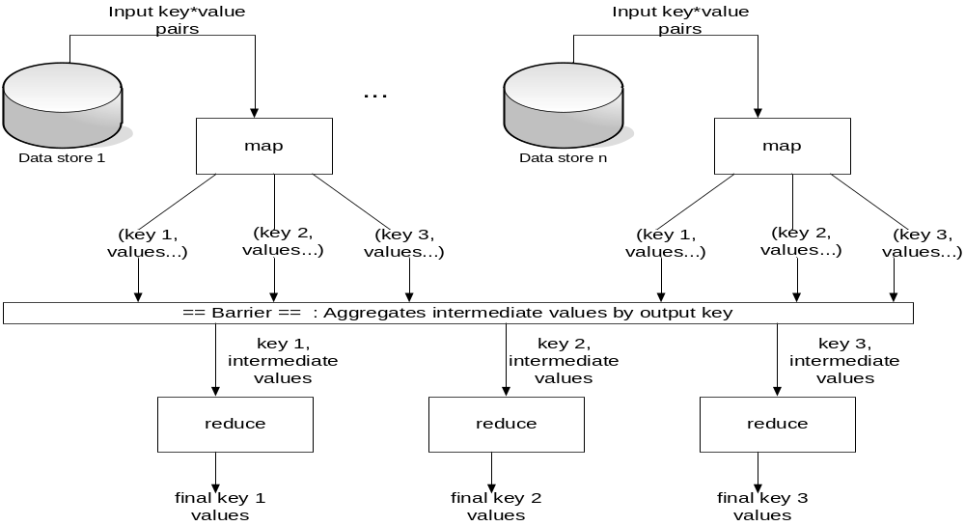
Architecture

Slide 12
Example: Count word occurrences
map(String input_key, String input_value):
// input_key: document name
// input_value: document contents
for each word w in input_value:
EmitIntermediate(w, "1");
reduce(String output_key, Iterator intermediate_values):
// output_key: a word
// output_values: a list of counts
int result = 0;
for each v in intermediate_values:
result += ParseInt(v);
Emit(AsString(result));

Slide 13
Example
Page 1: the weather is good
Page 2: today is good
Page 3: good weather is good.

Slide 14
Map output
Worker 1:
  (the 1), (weather 1), (is 1), (good 1).
Worker 2:
  (today 1), (is 1), (good 1).
Worker 3:
  (good 1), (weather 1), (is 1), (good 1).

Slide 15
Reduce Input
Worker 1:
  (the 1)
Worker 2:
  (is 1), (is 1), (is 1)
Worker 3:
  (weather 1), (weather 1)
Worker 4:
  (today 1)
Worker 5:
  (good 1), (good 1), (good 1), (good 1)

Slide 16
Reduce Output
Worker 1:
  (the 1)
Worker 2:
  (is 3)
Worker 3:
  (weather 2)
Worker 4:
  (today 1)
Worker 5:
  (good 4)

Slide 17


WordCount on Hadoop
1 start hadoop
step1:
Login to Ubuntu as haduser
step2:

Slide 18
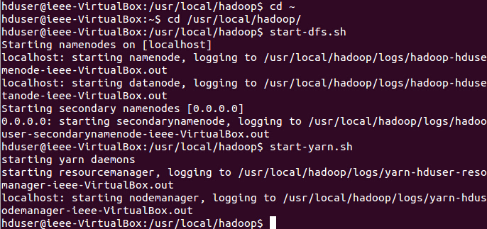
WordCount on Hadoop
1 start hadoop
step3:

Slide 19
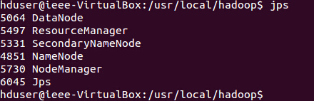
WordCount on Hadoop
1 start hadoop
step4: to check whether your hadoop is working in your web browser:
  Cluster status: http://localhost:8088
  HDFS status: http://localhost:50070
  Secondary NameNode status: http://localhost:50090
  And also, you can do to see whether you get similar output:

Slide 20
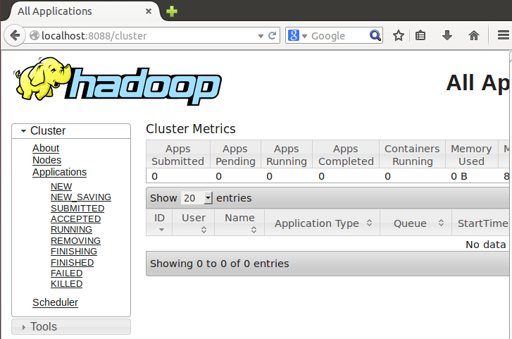
WordCount on Hadoop
1 start hadoop

Slide 21

WordCount on Hadoop
2 to create a directory and add files in
step1:

Slide 22
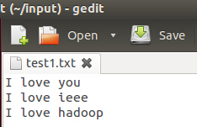
WordCount on Hadoop
2 to create a directory and add files in
Step 2:
in test1.txt you can write down anything you like ,eg:

Slide 23
WordCount on Hadoop
3 to copy files to hdfs
4 to run the wordcount example

Slide 24

WordCount on Hadoop
5 the process of Map&Reduce

Slide 25
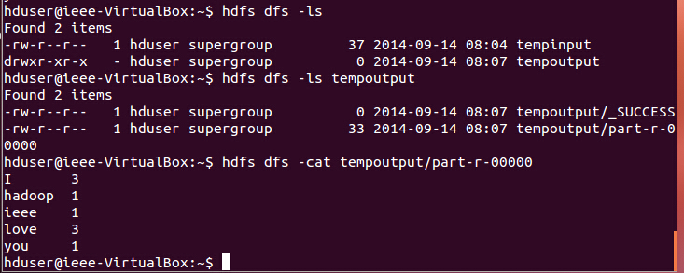
WordCount on Hadoop
6 the result:

Slide 26
Mini Exercise
There is another example to compute π. The command is as follows:
$ hadoop jar /usr/local/Hadoop/share/Hadoop/mapreduce/Hadoop-mapreduce-examples-2.2.0.jar pi <nMaps> <nSamples>
*where <nMaps> is the number of mapper jobs and <nSamples> is the number of samples

Slide 27
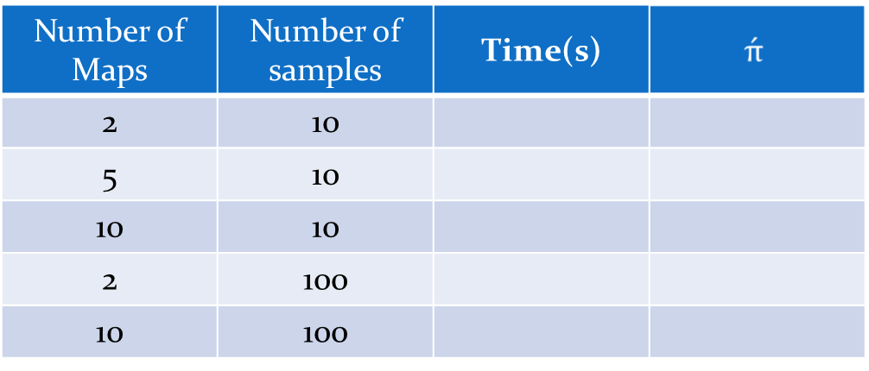
Mini Exercise
Exercise : 1 practise using basic hadoop command and fill in the following table
how does the running time and precision change?

Slide 28
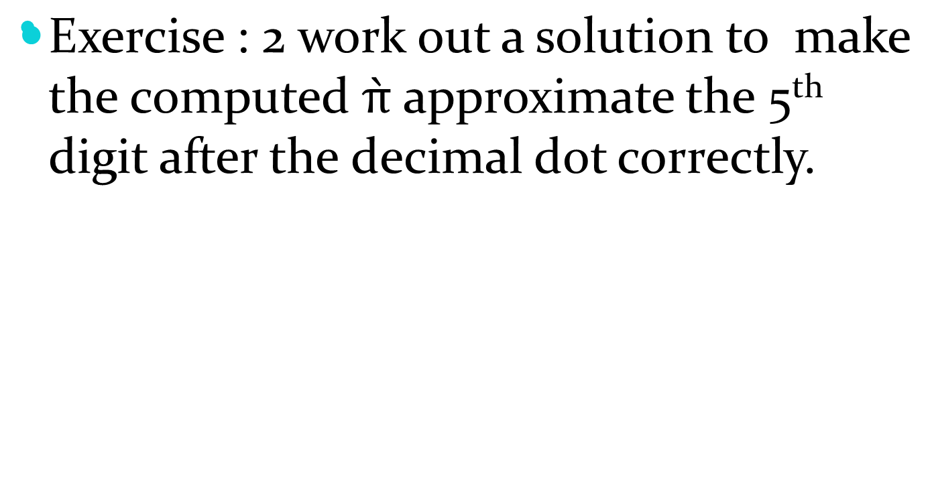
Mini Exercise

Slide 29

Questions and Answers !!!

